Slide 1
Row Pergfect 1.0
Brian McKeown

Slide 2
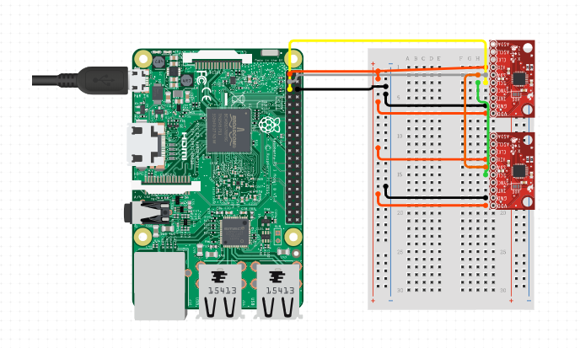
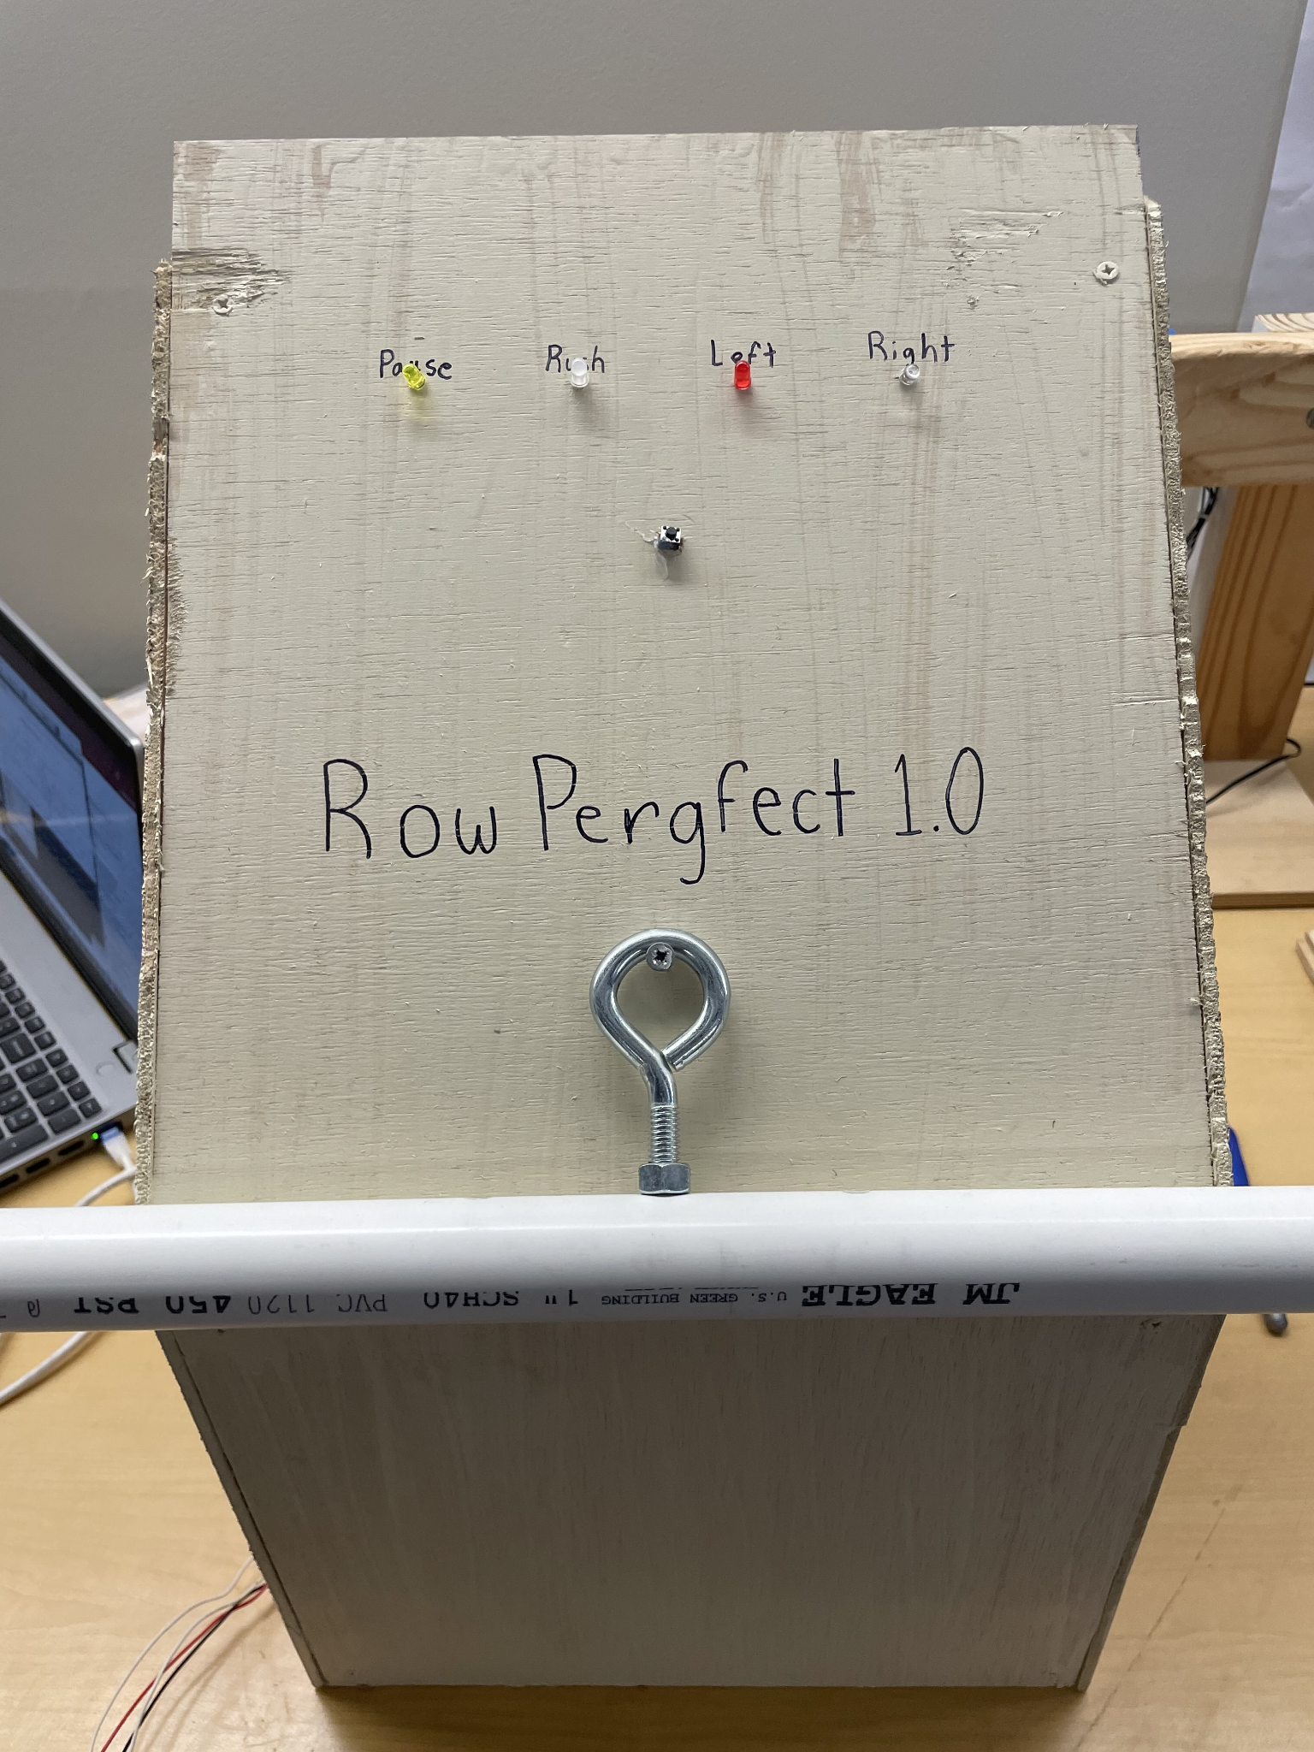
Smart Handle
The Smart Handle was made made using 2 MPU6050 gyroscope and accelerometers.
This allowed data to be collected from each side of the handle for a more accurate reading.
One IMU was placed on each end of the handle.
This is a wiring diagram of how the IMUs were connected to the raspberry pi in the handle.

Slide 3
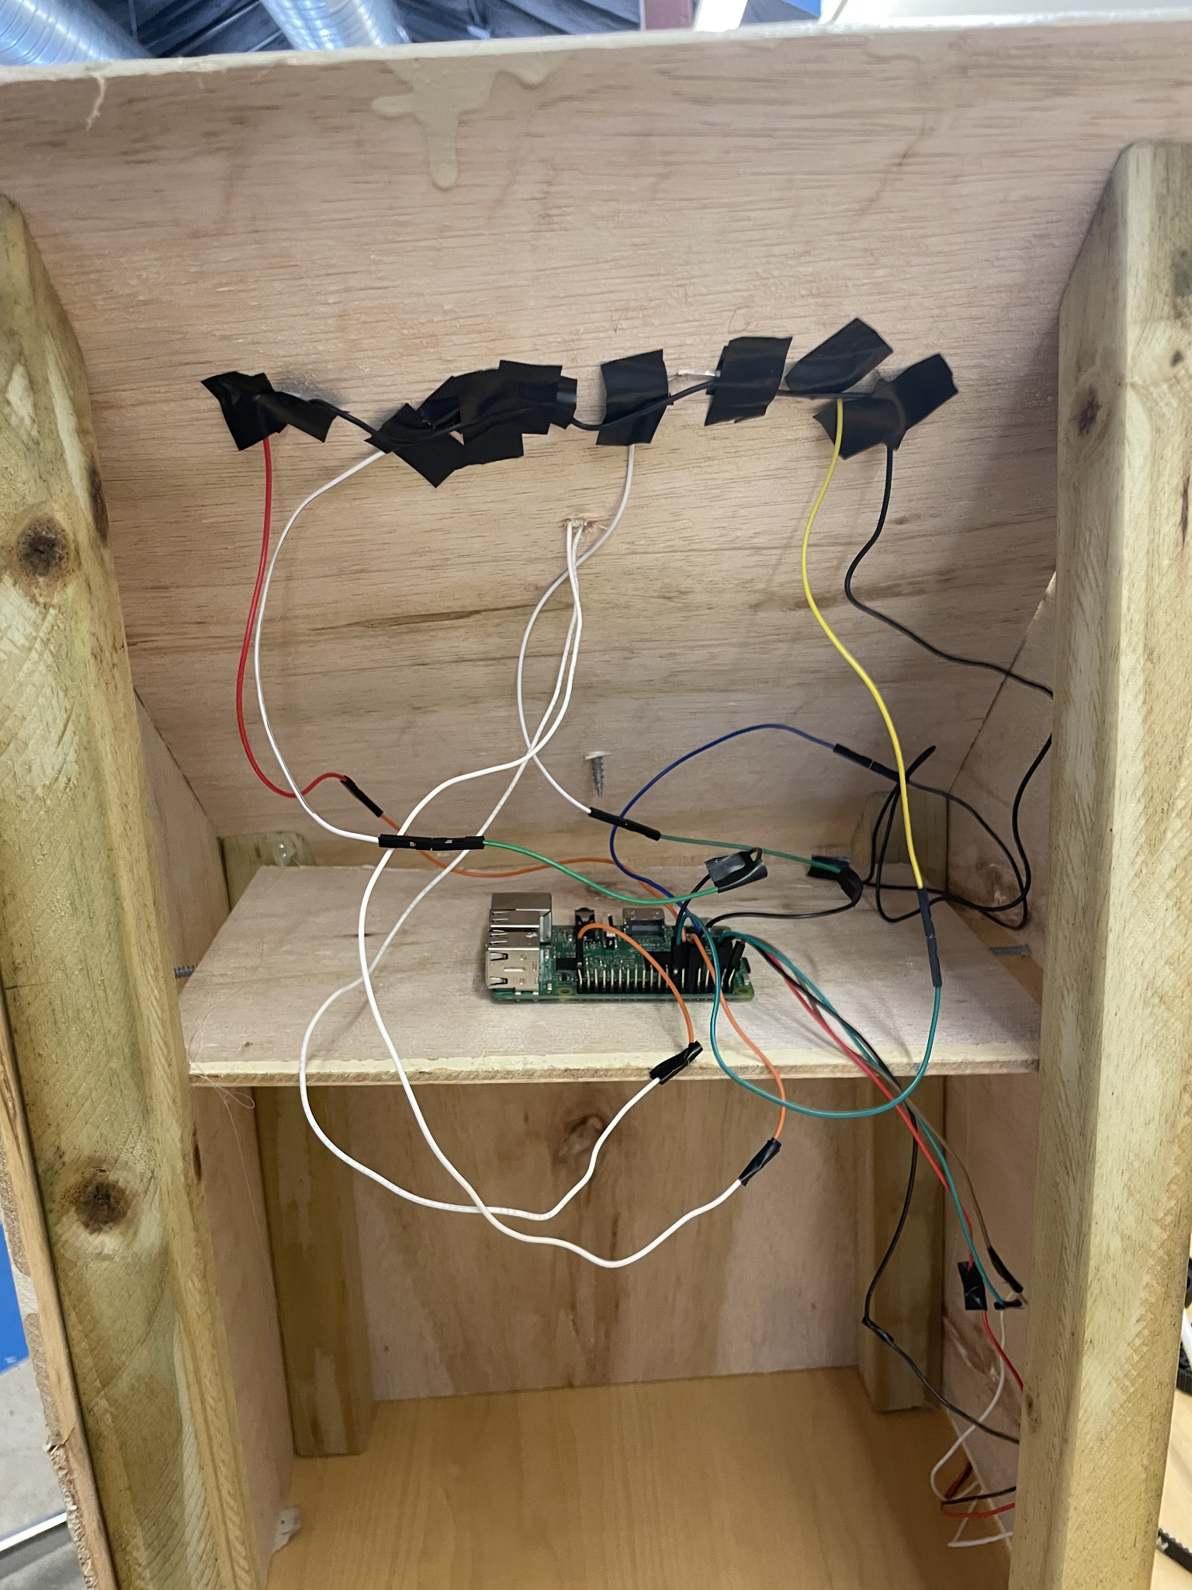
Housing
The housing contains 4 LEDs one for each improper stroke action that is being measured
It also has a start button in the middle that begins collecting data.

Slide 4
Functionality
To use the project, plug it into the wall and press the center button. Begin taking strokes with handle and see the LEDs light up for the following problems:
Pause - This checks to see if you are taking a pause in your stroke at any point. This is a common problem as people tend to pause at the end of their stroke.
Rush - This checks to see if you are moving too fast on your recovery. People tend to rush when they want to speed up but this is a problem because it checks the boat and make moving less efficient.
Left - This checks to see if you are pulling in to the left side of your body
Right - This checks to see if you are pulling in to the left side of your body

Slide 5
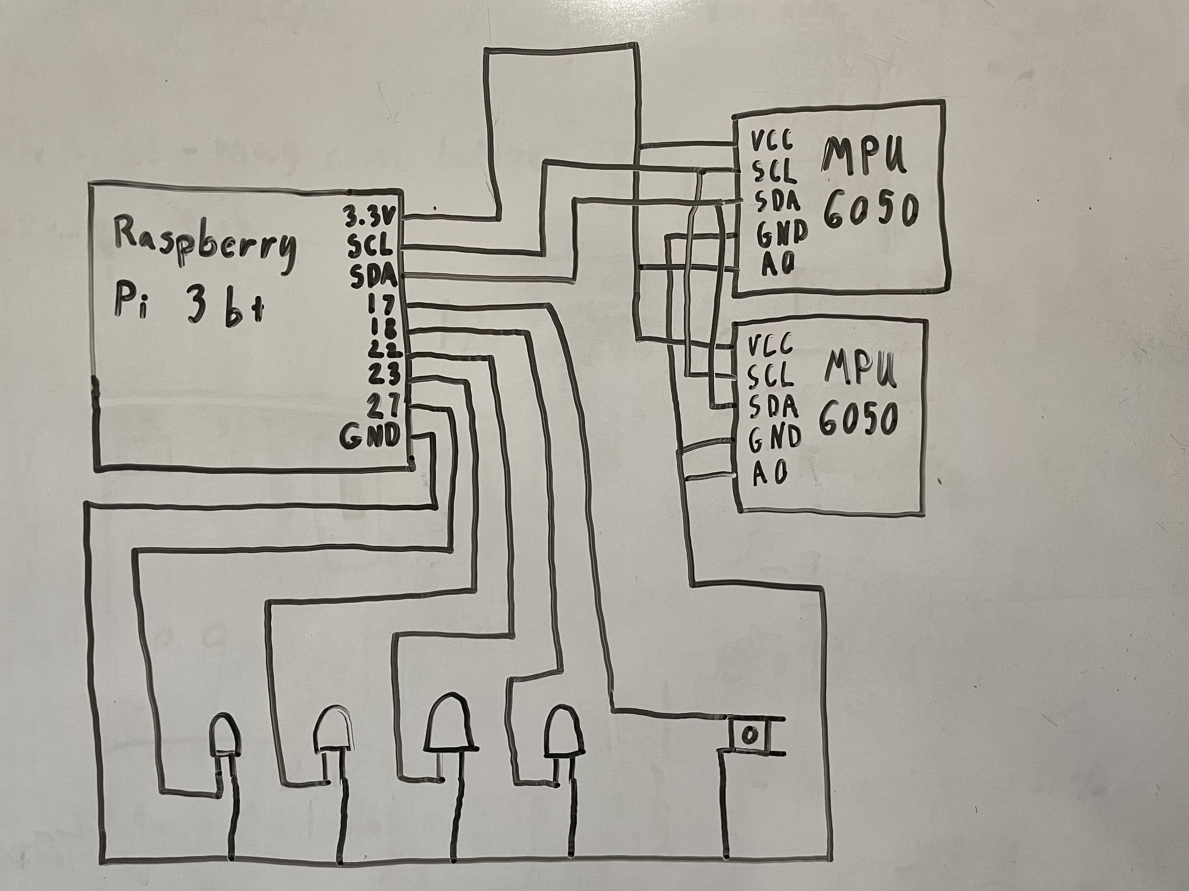
Wiring Diagram

Slide 6
Theory/Model Overview
Used a switch variable and two different threshold values to measure the length of the stroke.
Took an average of the X acceleration values and if there was a value more than the 90 percentile plus 2 m/s^2 it would be marked as a rushed stroke.
If there were any noticeable variations in the Y acceleration, depending on the direction it would be marked as a left or right stroke.
If the values for the acceleration stay close to the same value for certain window of time it would be marked as a pause.

Slide 7
Results
Successfully identified most improper strokes
Accuracy could be improved
Multiple improper stokes in succession of one another confuses the software
Pause duration should be shortened as it takes too long to identify a pause.

